Slide 1

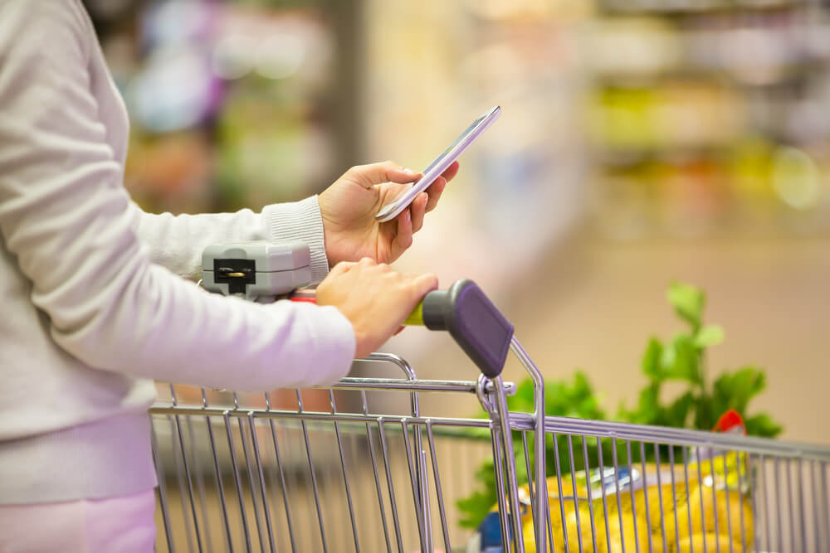
KindNerds Inc. - Presentation
By: Fen Hue Ly, Lan Xu, Thioro Faty, Xavier Mougeot
Course: CEBD 1151 - Big Data Analytics for Business

Slide 2
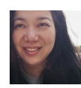



Introductions – team
Fen Hue Ly
Lan Xu
Thioro Faty
Xavier Mougeot
KindNerds Inc. is a startup company created in 2019 and located in Montreal.
Being in such a dynamic information technology environment, the company would like to put its stamp as well and become a leader in the big data market.
KindNerds Inc. aims at bringing innovation in the heart of everything and make people life much simpler.
In that optic, we have developed a new mobile application called UShop that will be the essence of this project.

Slide 3
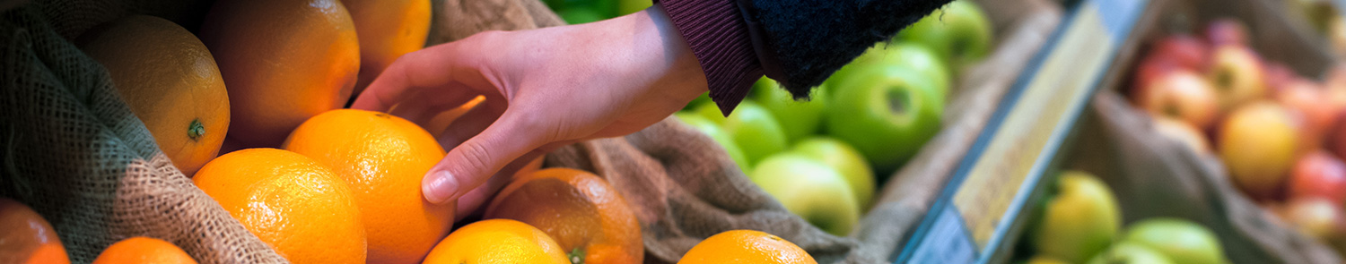
Our time today
1. Problem
2. Data Description
3. Business Definition
4. Customer Journey Mapping
5. AA/ML/AI applications
6. Visualization
7. Business outcomes

Slide 4
The Problem
1

Slide 5
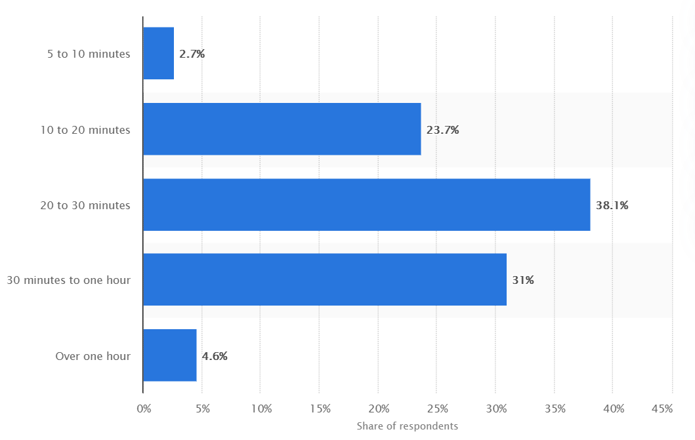
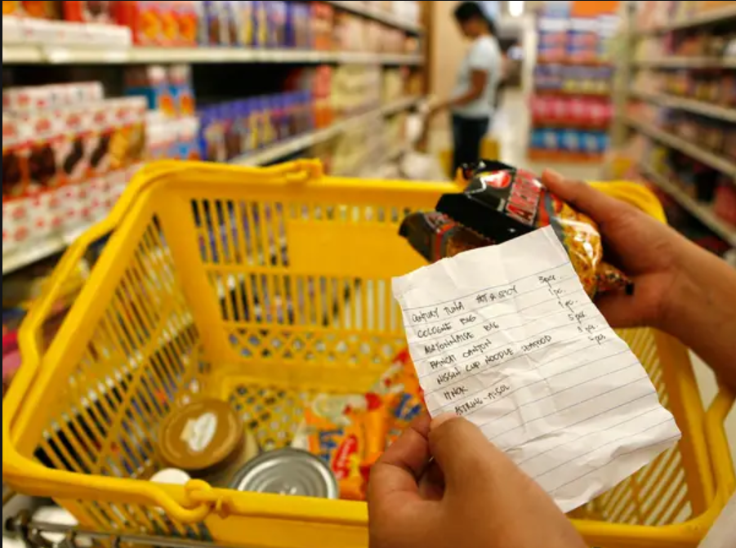
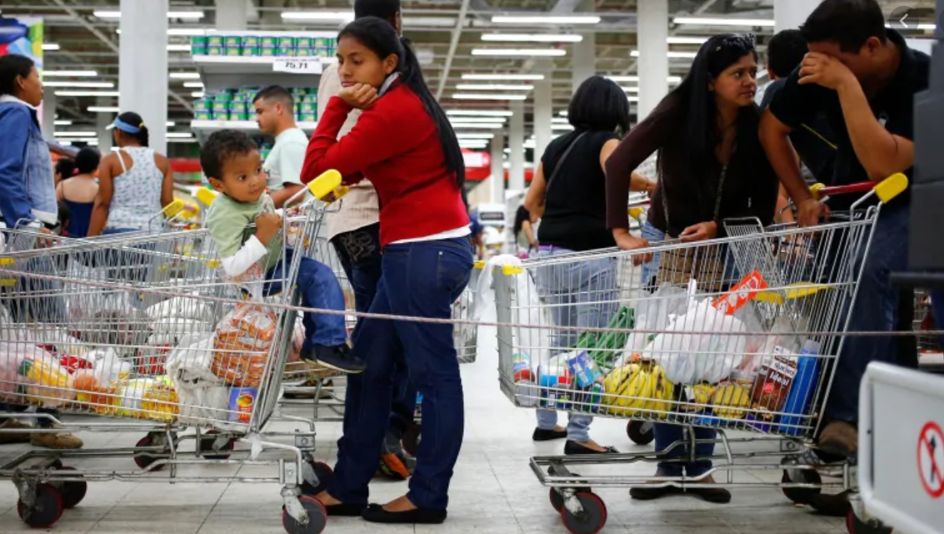
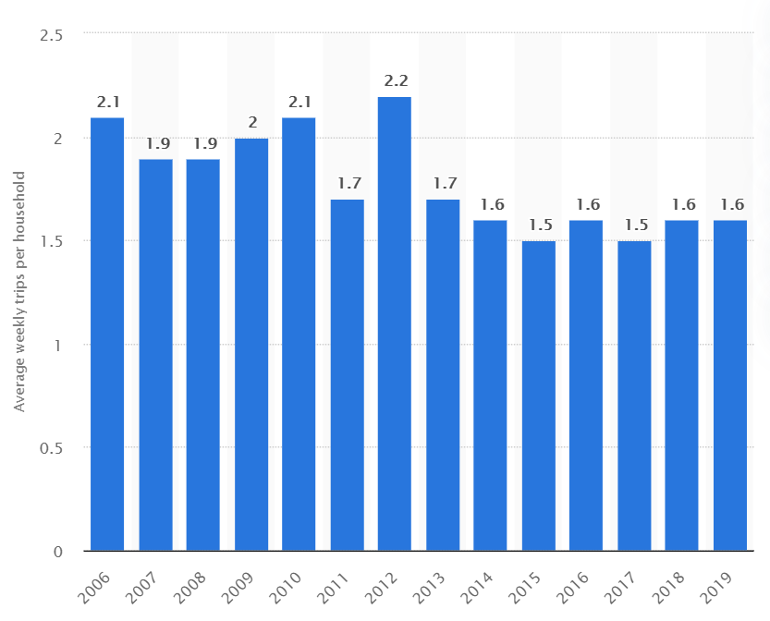
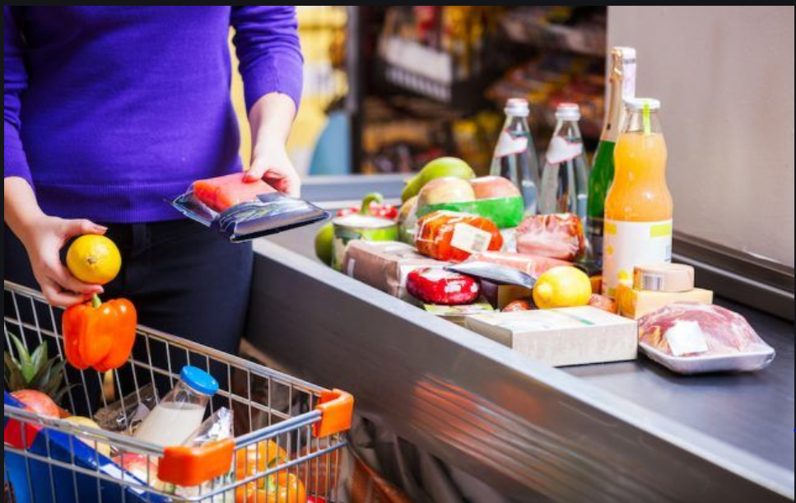
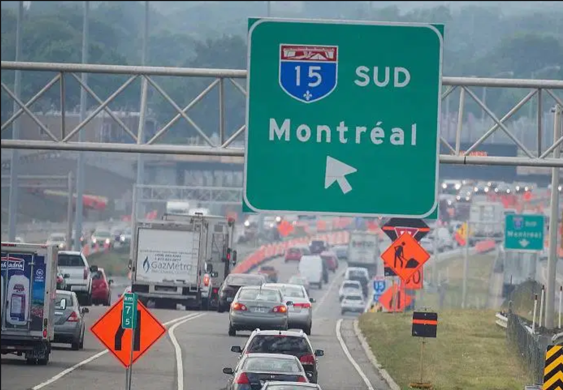
Grocery shopping problems - Shopper
Shopper’s pain point
Long time to zig-zag through aisles
Long line to wait for checking out
An arduous chore
Traffic on the road
Length of Canadian consumer visits to grocery stores 2018
Canadian consumers' weekly trips per household 2006-2019

Slide 6
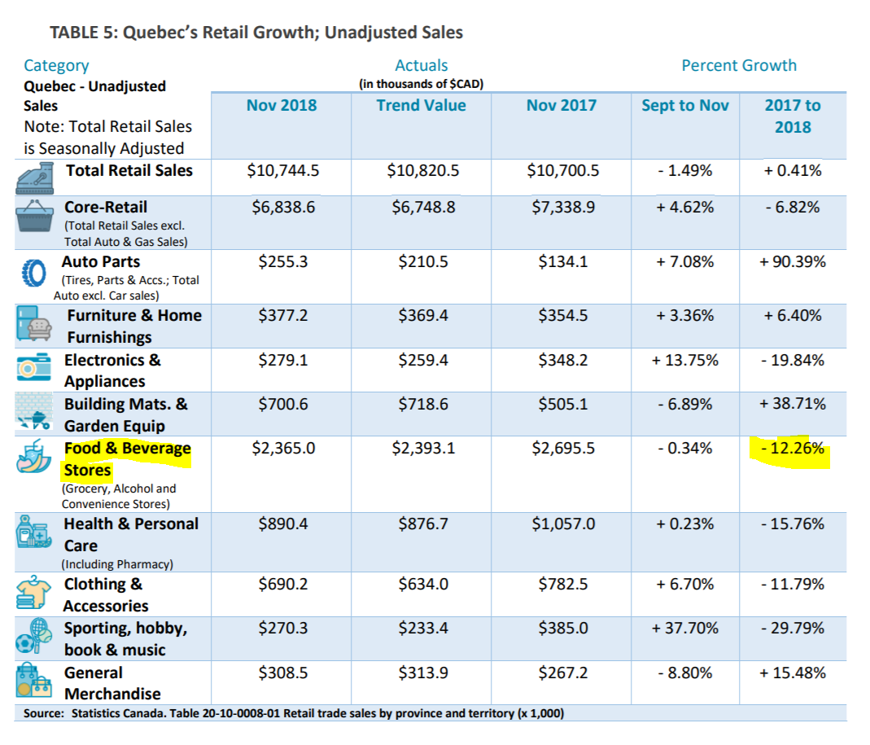
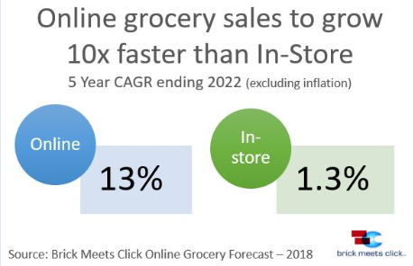
Grocery shopping problems - Stores
Grocery Industry status
High competition from Online grocery
Lower Growth rate for the whole industry

Slide 7
Data Description
2

Slide 8
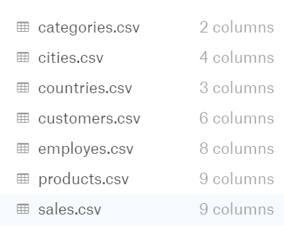
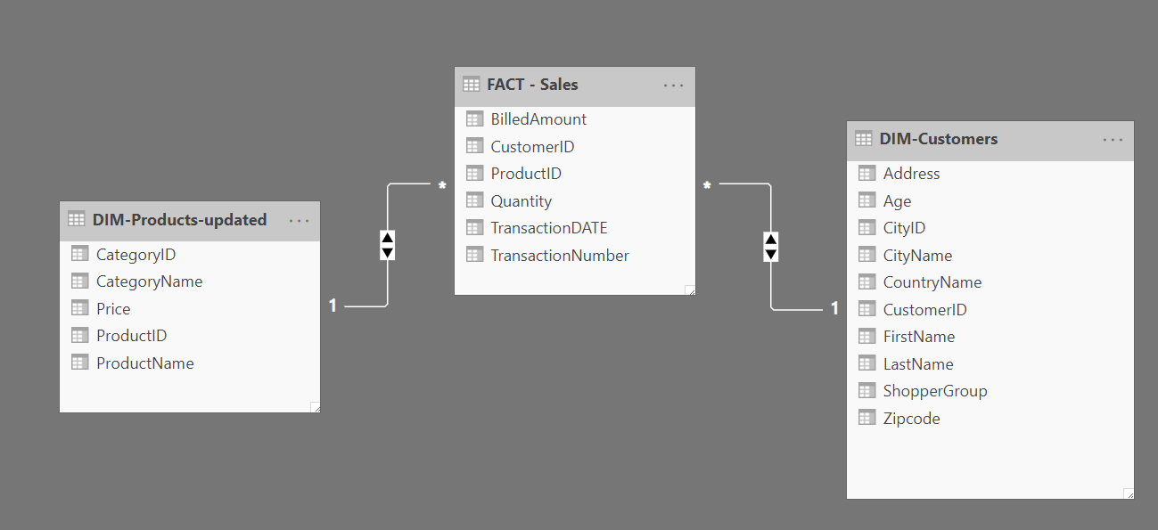
Dataset Description
Dataset Source:
https://www.kaggle.com/marcinex1423/salesdb-grocery
Dataset Structure: Star Schema
Dataset coverage:
Date: 1-1-2018 to 5-9-2018
Area: USA 96 cities grocery transaction data
Grocery stores: unspecified
Represent
Chain-supermarket transaction datasets

Slide 9
Business Definition
3

Slide 10
Business Definition
Develop a grocery mobile app (UShop): it allows users to:
Shopper can activate an online transaction at the same time when user pick up shopping cart.
Shopper can use the built-in bar code scanner to add product to online basket.
Shopper can pay the bill online without waiting for the check out line.
Digital receipt generated in UShop.

Slide 11
Customer Journey Mapping
4
Notes:
So will start with the team introductions

Slide 12
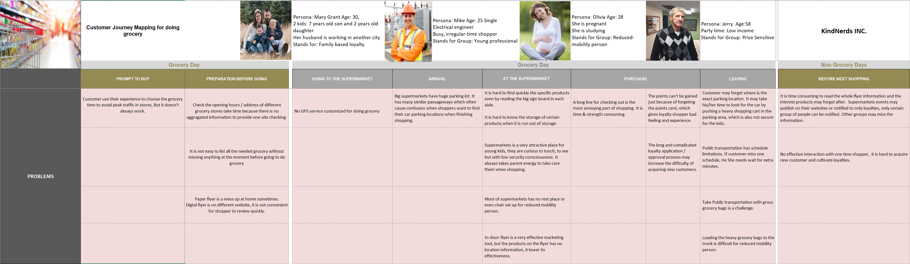
Customer Journey Mapping

Slide 13
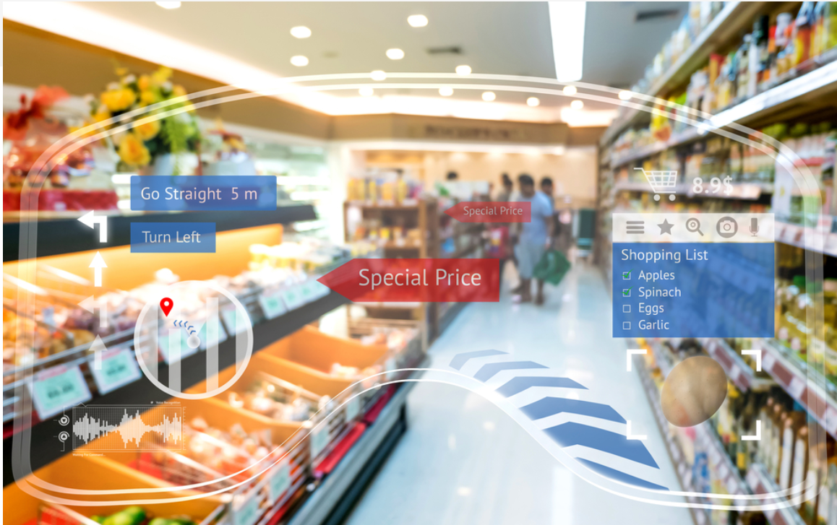
Customer Journey Mapping
We add more futures on UShop mobile app:
Show stores information with opening hours / address and add real-time Store Traffic checking features.
Add "My Shopping List" feature.
Add "Digital Flyers" feature.
Stores loyalty cards (Airmiles program) and gift cards on the app.
Add "EVENTS" feature (Black Friday, Christmas, etc.)
Collaborate with GOOGLE MAP and add GPS features in UShop. (Phase II)
Collaborate with Uber delivery. ((Phase II)

Slide 14
AA/ML/AI applications
5

Slide 15
Advanced Analysis Opportunity
Predict how many consumers will use UShop for marketing promotion purpose
1. Data collection: Design a digital questionnaire.
2. Data modelling: Fit our collected data to logistic regression model with labels of:
- Yes, I want to download! vs. - No, I don’t want to download!
3. Feed specific grocery store’s customers dataset to this model for predicting the potential amount of user of UShop.
Questionnaire Sample
Questions | Answers
Age
Gender
City
Frequency of shopping
Shopping duration
Will you download UShop? | Yes No
…

Slide 16
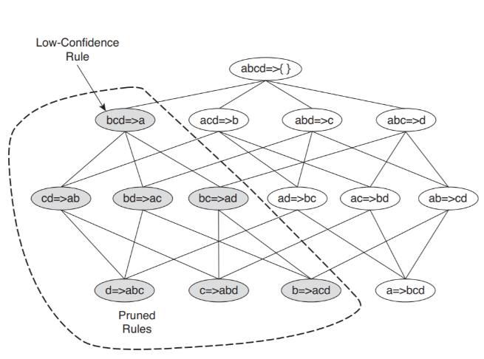
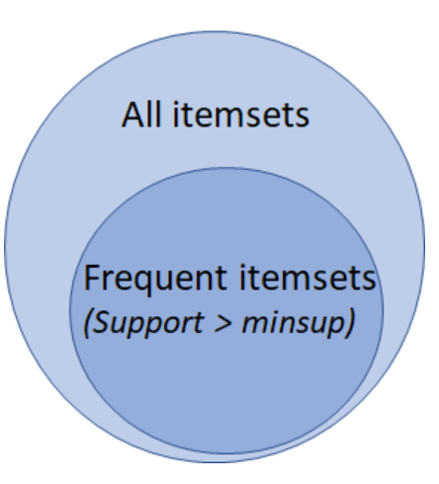
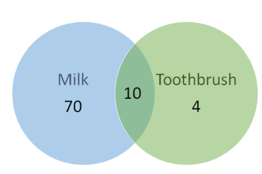
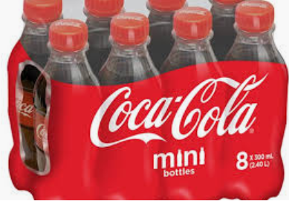
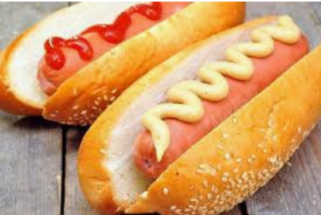
Machine Learning Opportunities
1. Optimize products placement within stores to facilitate customer purchases.
Association rule learning - The Apriori algorithm
- The Association Rule: {X → Y}
- The Itemset: {X, Y}
- Support
- Confidence
- Lift
First step is to get all the frequent itemsets. We seek only frequent itemsets.
The second step is generating all possible rules from the frequent itemsets.
The last step is to feed result to The Apriori algorithm to search for highest values of lift to make business decisions.
Application case:
Suppose we find out one of the combinations is Coco Cola and hot dog, UShop will send suggestions to grocery stores manager :
Model chosen reasons:
Association rule learning is an unsupervised learning.
It is easier to interpret and visualize business suggestions to store managers than Neural network.
It is cheaper and faster in terms of calculations.

Slide 17
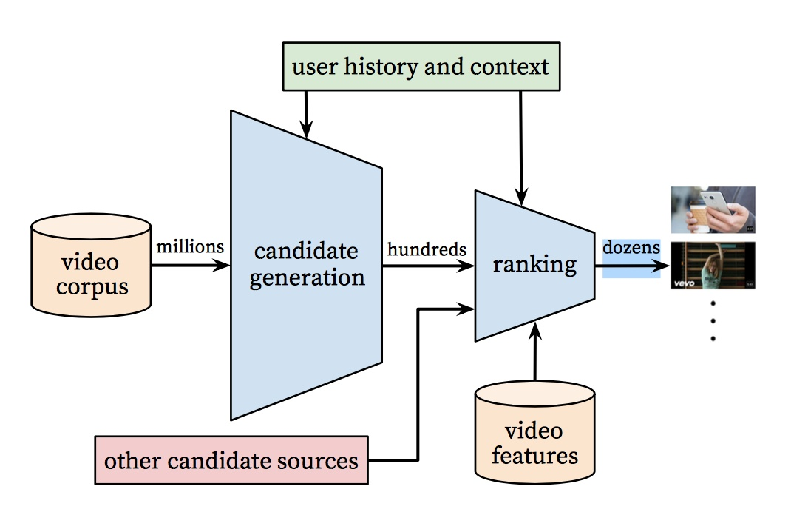
Machine Learning Opportunities
2. Intelligent Recommendation strategy.
YouTube's recommendation system
UShop recommendation system
UShop
App
Products
Produtcs
features
Model chosen reasons:
Using two frameworks of N.N. we believe the accuracy will be higher than tranditional recommendation model like collaborative filtering and clustering algorithms.

Slide 18
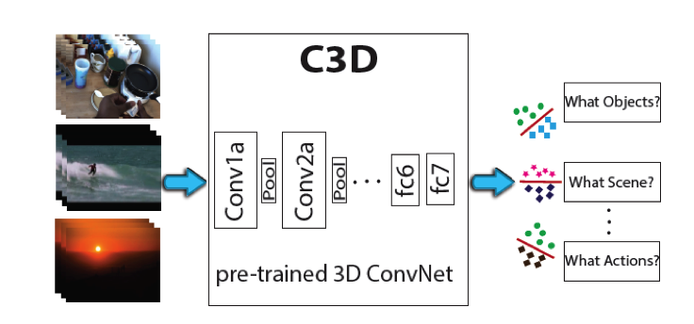
Machine Learning Opportunities
3. Install cameras on shopping carts to avoid customer Fraud.
1. Identification of the action of adding/removing goods
2. Object detection/classification:
Model chosen reasons:
CNN is the most suitable model for image processing. (C3D is CNNNet, is able to identify Objects/Scene/Actions.)
SqueezeNet model is often used for M/L running on mobile, which has less calculation.
We add more futures on UShop mobile app:
Real-time Recommendation (with product placement info like aisles & shelf for easy looking for products.
Add reminder features if shopper forgot to add the product into online shopping cart.

Slide 19
Visualization
6

Slide 20
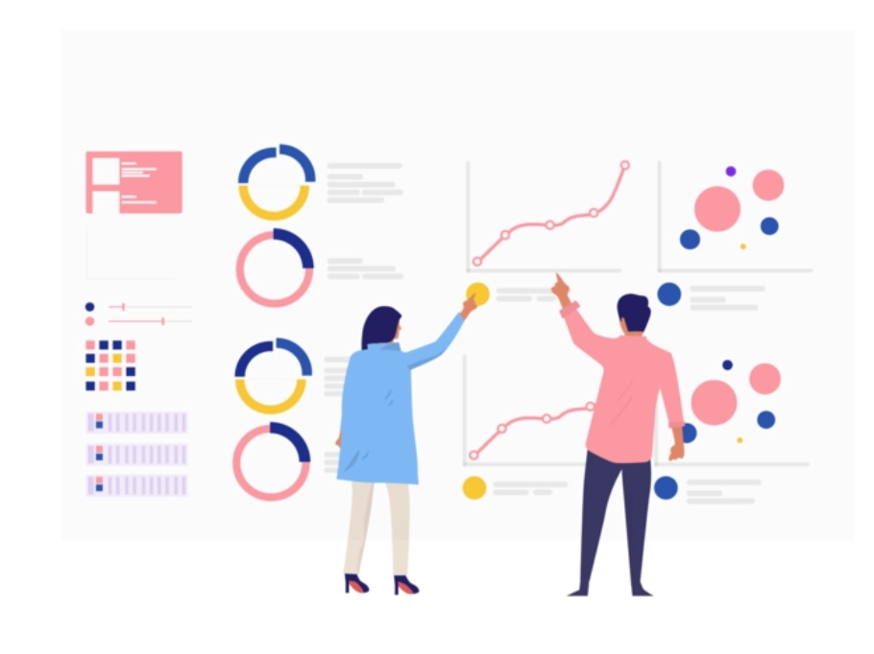
UShop Dashboard Design
For Grocery Stores
- Sales Revenue analysis (Different Locations – for chain-supermarkets)
- Product analysis (Top Purchased products / Associated products …)
- Shopper analysis (Segments purchase characteristics …)
For Shopper
- Purchase analysis (Total Spending / Most frequent spending on Top N products /spending trend…)

Slide 21
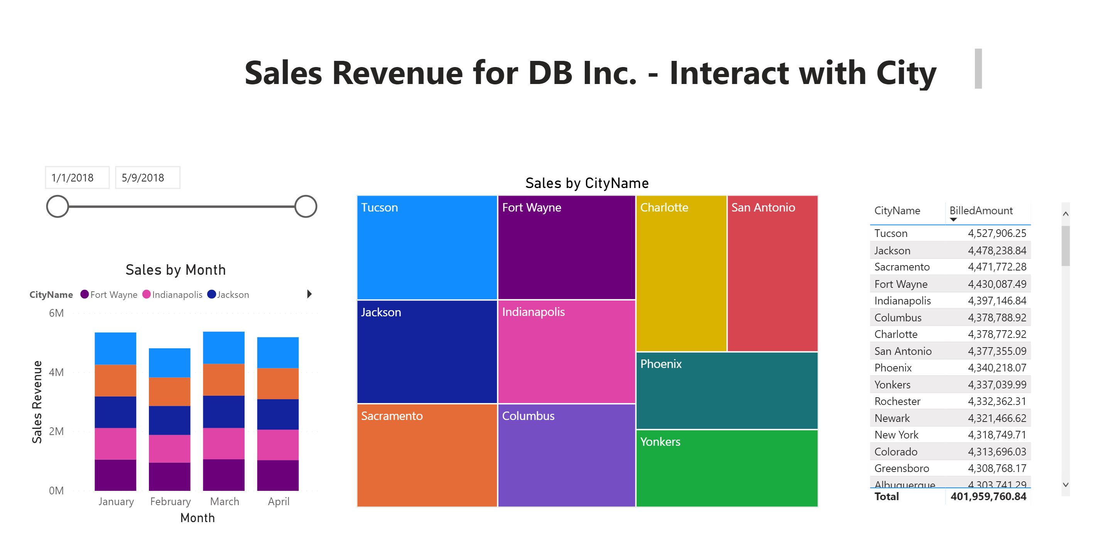
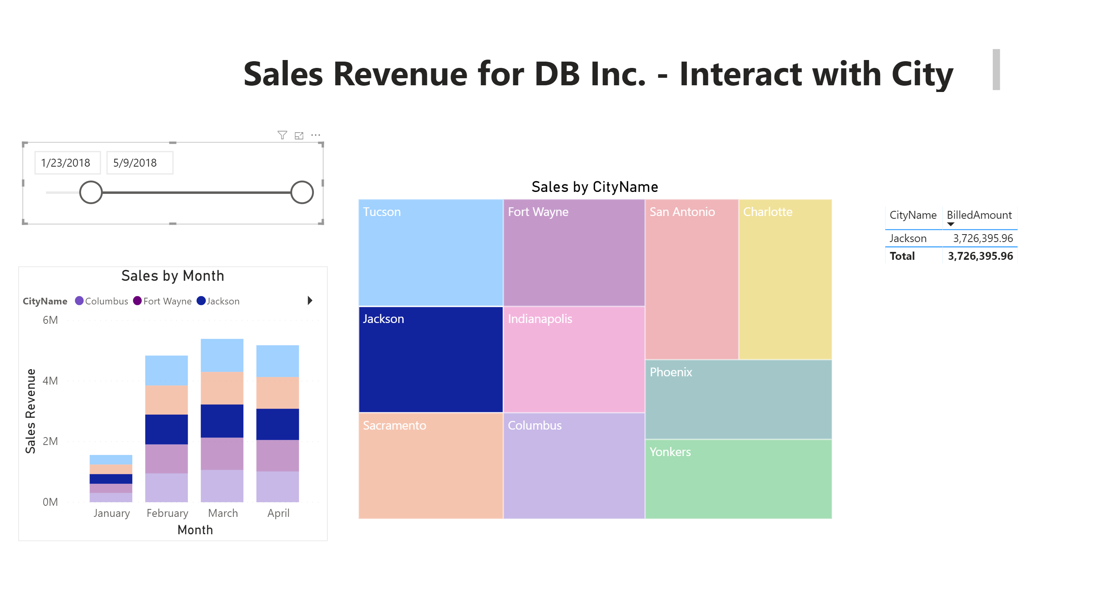
UShop Dashboard for GROCERY STORES – Demo I

Slide 22
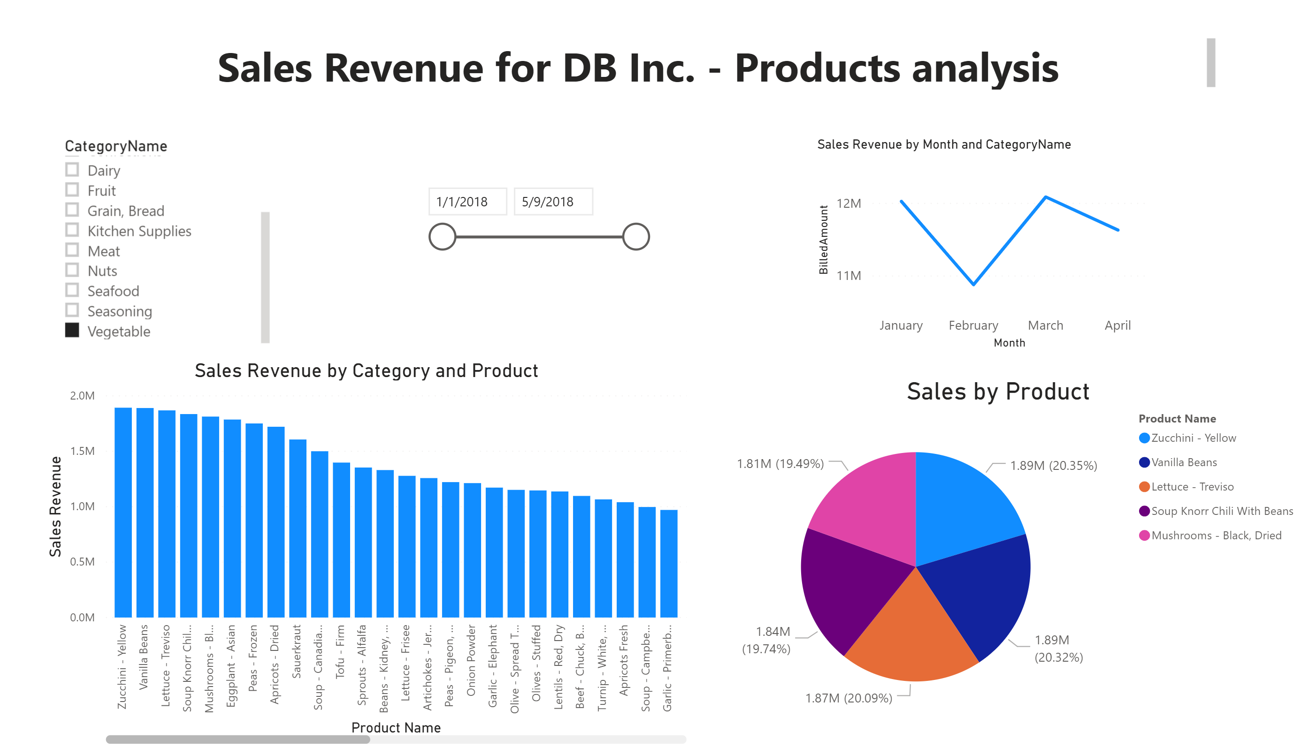
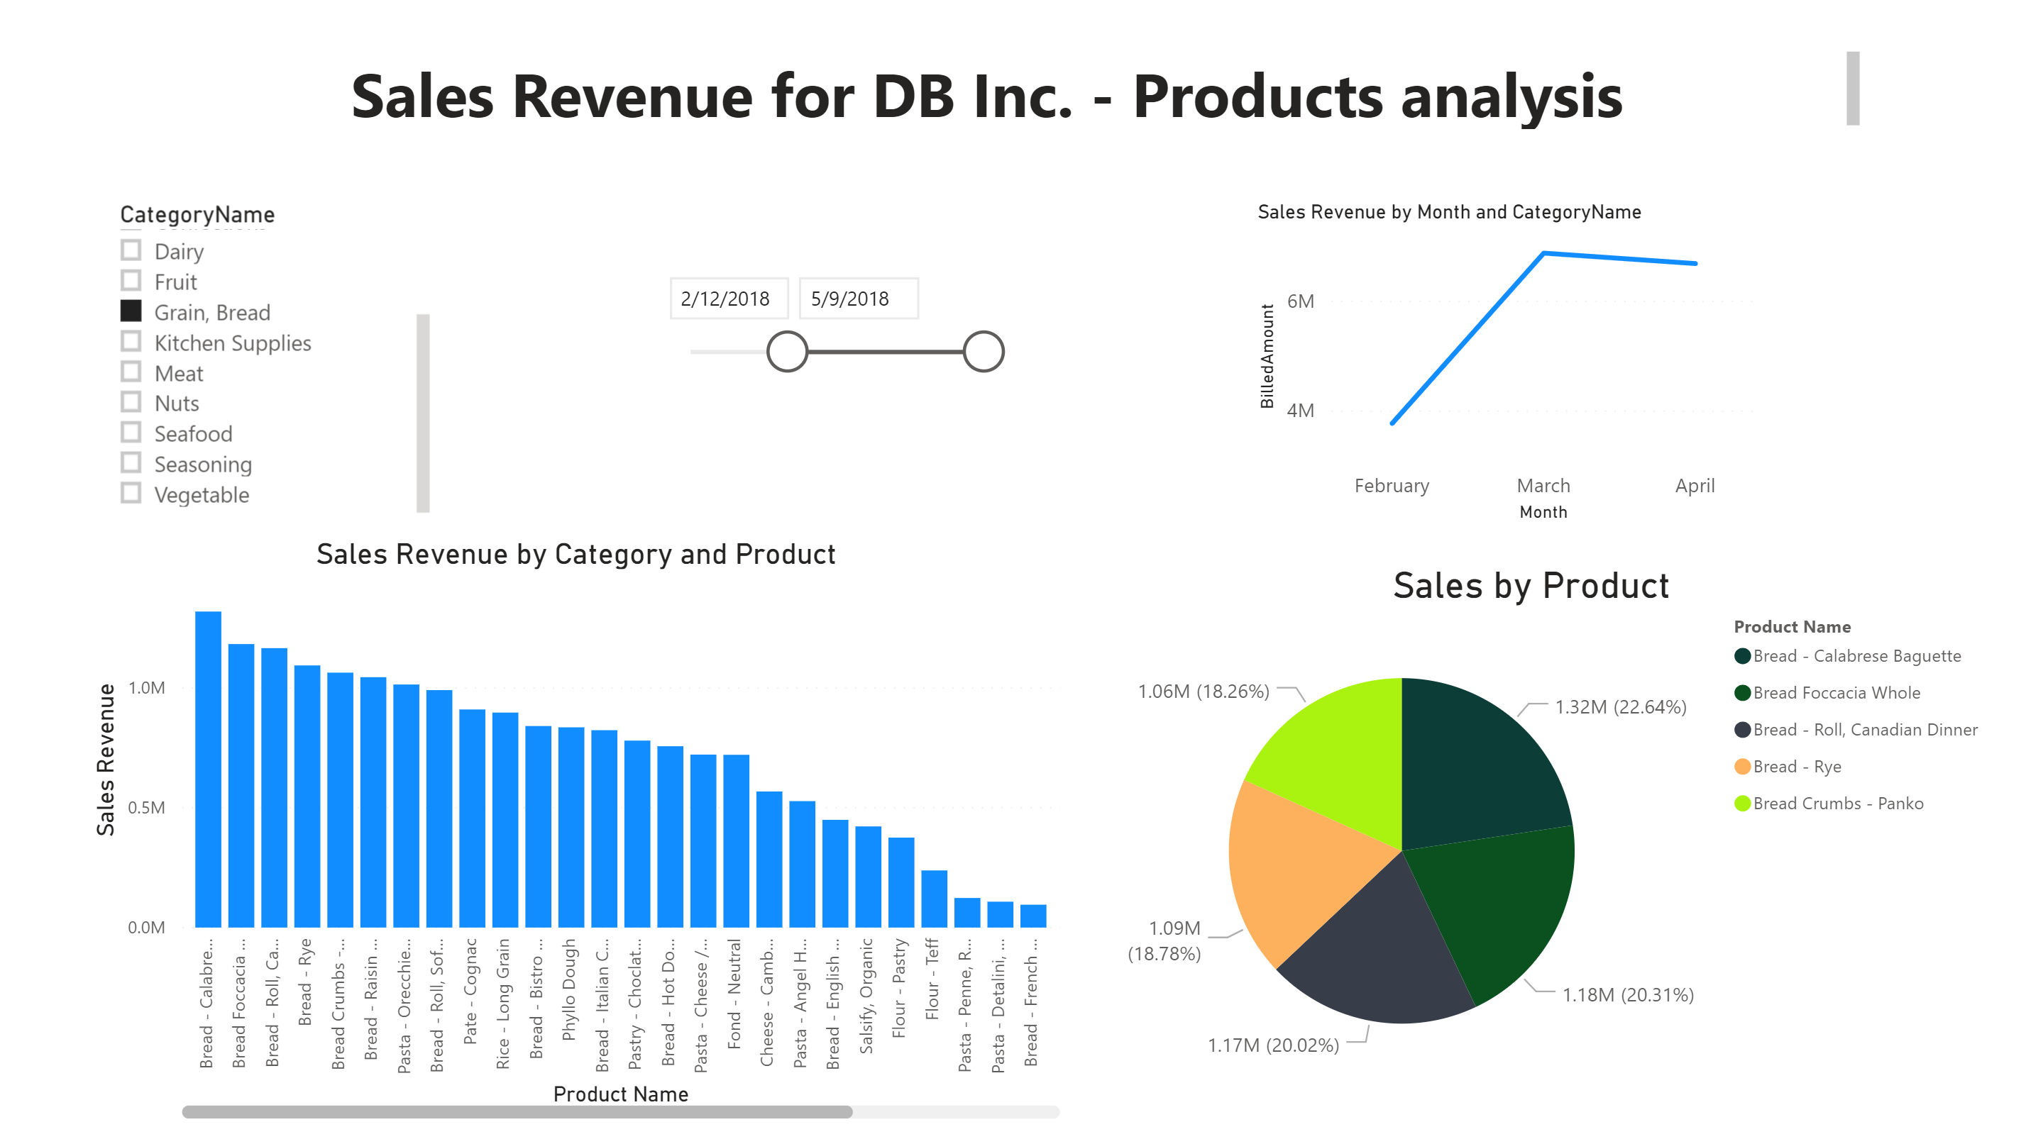
UShop Dashboard for GROCERY STORES – Demo II

Slide 23
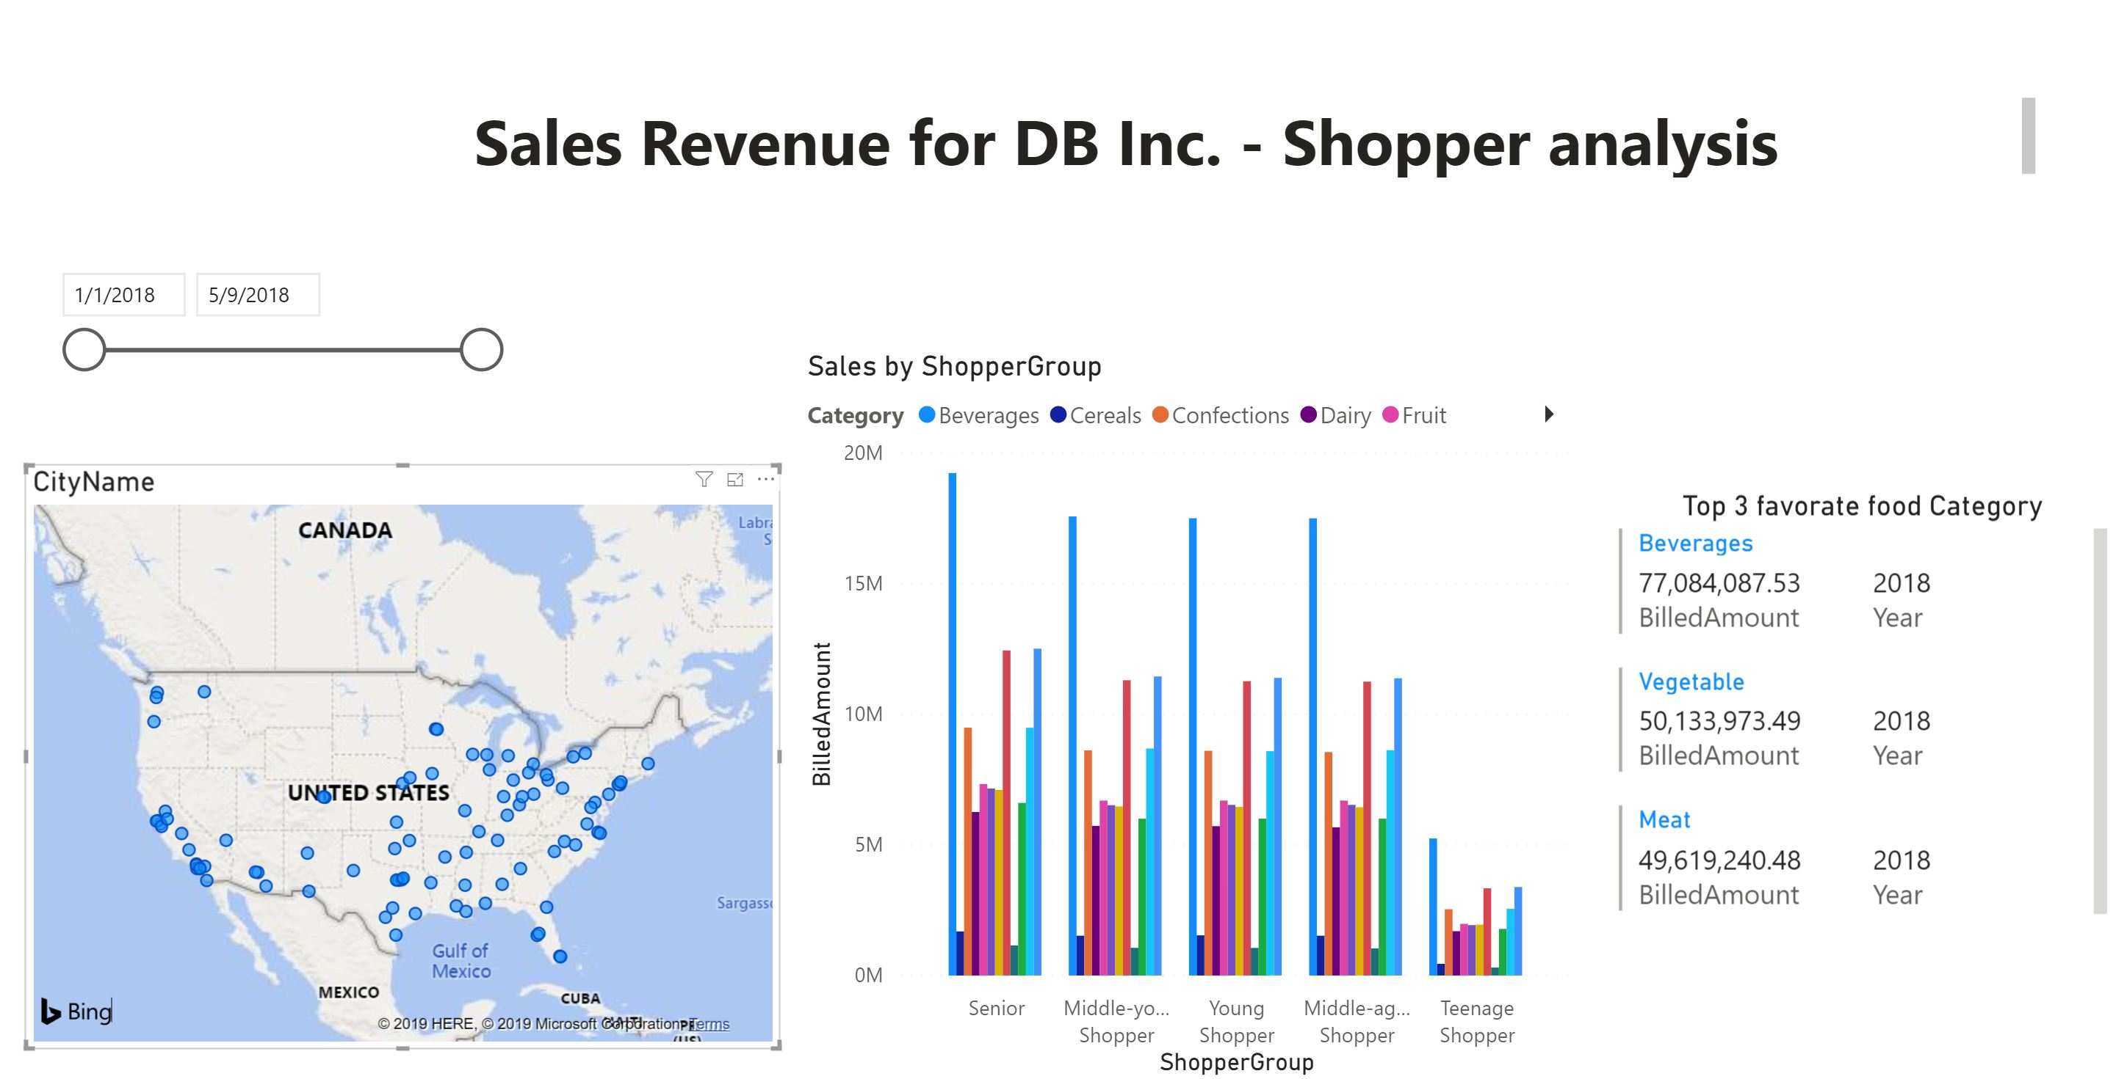
UShop Dashboard for GROCERY STORES – Demo III

Slide 24
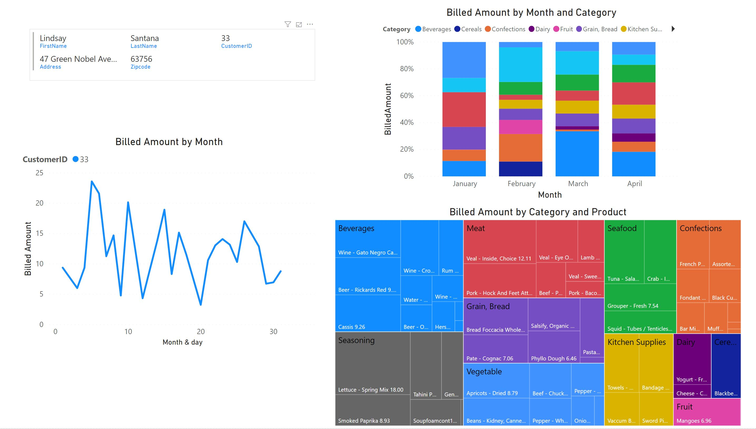
UShop Dashboard for SHOPPER – Demo I

Slide 25









Data Architecture
Social Media API
Data Lake
UShop
(API)
RESTful API Containers for Models （Recommendation /products map /predictive trends…)
UShop
Mobile
UI
Trained model with live data
Use trained model
Maxi
(API)
HIVE
IGA
(API)
YARN
HDFS
UShop
Web UI
Data Ingesting
Data Storing
Data Processing
Data Modelling
Data Visualizing

Slide 26
Business Outcomes
7

Slide 27
UShop, what’s next?
Exclusive drive-thru section in grocery stores for basic needs. (Reinforcement Learning)
Link to Uber API for delivery option
Develop real-time inventory information for consumers’ improved shopping experience.
UShop login via social media account (NLP opportunity to analyze the user's preferences on grocery)
Collaborate with GOOGLE MAP and add GPS features in UShop. (For transit)

Slide 28
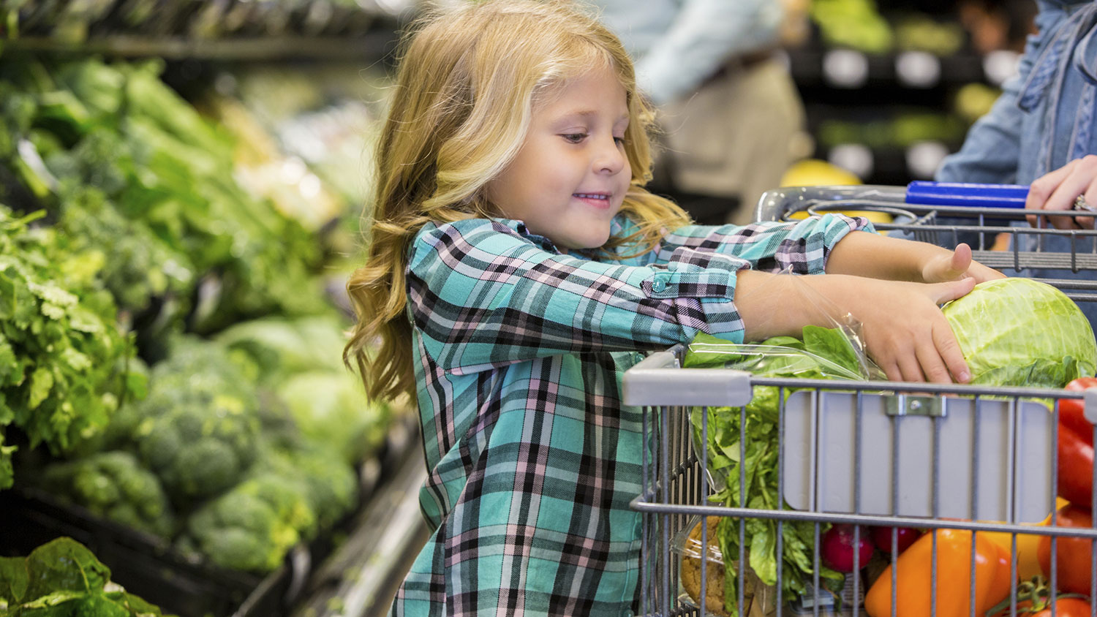
…Thank you/Merci !

